Slide 1
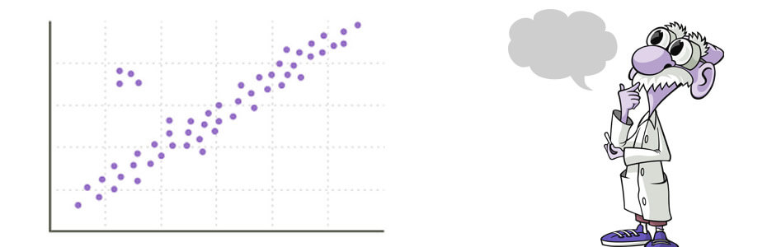
Regression
This Photo by Unknown Author is licensed under CC BY-SA-NC

Slide 2
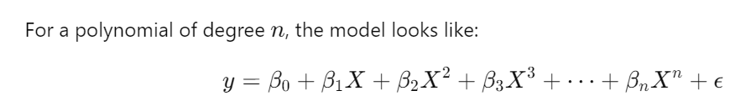
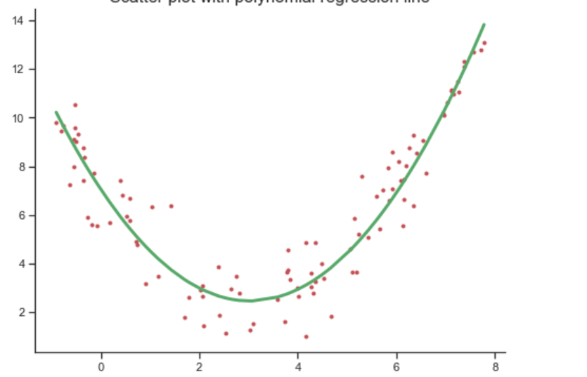
Polynomial Regression
Polynomial regression is a type of regression analysis where the relationship between the independent variable X and the dependent variable y is modeled as an nth degree polynomial.

Slide 3
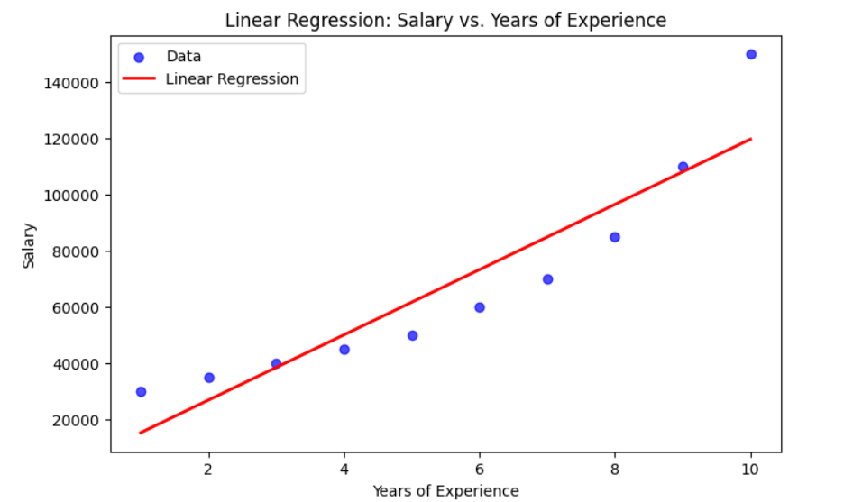
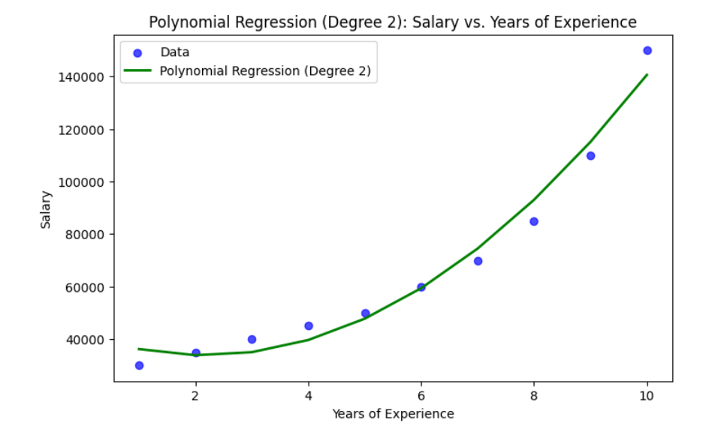

Why Use Polynomial Regression?
Non-linear Relationships: If the relationship between the independent and dependent variables is non-linear, polynomial regression can model the curvature in the data.
Flexibility: By adjusting the degree of the polynomial, you can fit a wider range of shapes to the data, providing a better fit compared to linear regression.
For example, a polynomial regression model of degree 2 (a quadratic model) is given by:

Slide 4
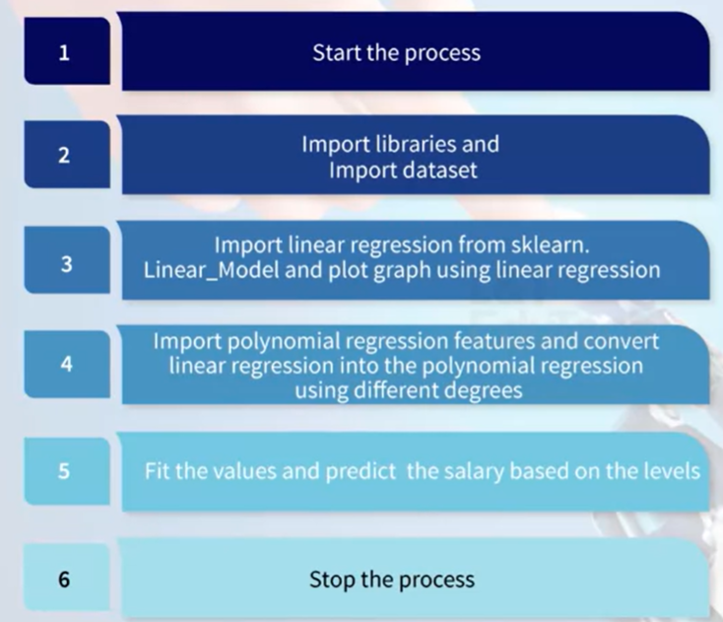
Steps –> Salary Prediction

Slide 5
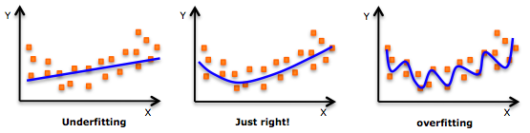
Overfitting and regularization in linear regression and logistic regression
Overfitting occurs when a model performs very well on training data but poorly on new, unseen data.
Underfitting occurs when a model is too simple to capture the underlying patterns in the data, resulting in poor performance on both training and test datasets.
Linear Regression:
Overfitting in linear regression happens when the model has too many features or a very high polynomial degree.
Logistic Regression:
Overfitting in logistic regression can also occur when there are too many features relative to the number of observations.

Slide 6
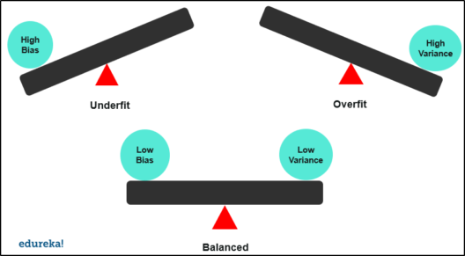
Bias and Variance
Bias refers to the error introduced by approximating a real-world problem, which may be complex, by a simplified model.
High bias means the model is too simple and may not capture the underlying patterns in the data.
Characteristics:
Underfitting occurs with high bias (High training error and high test error.)
The model makes strong assumptions about the data.
Variance refers to the error introduced by the model’s sensitivity to small fluctuations in the training data.
High variance means the model is too complex and may capture noise in the training data rather than the underlying pattern.
Characteristics:
Overfitting occurs with high variance (Low training error but high test error).
The model learns the details and noise in the training data.

Slide 7
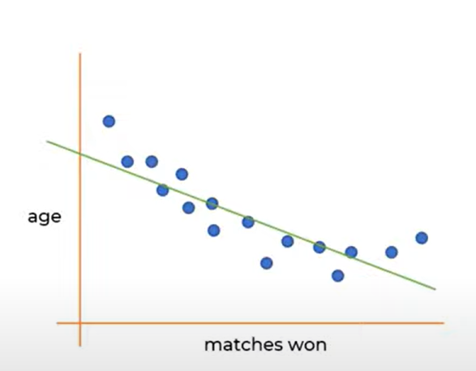
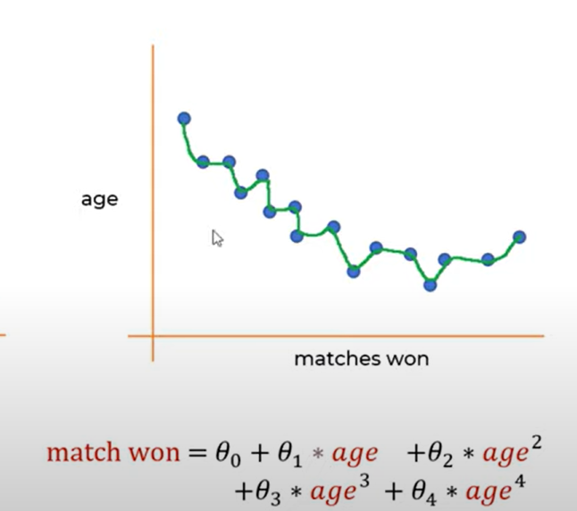
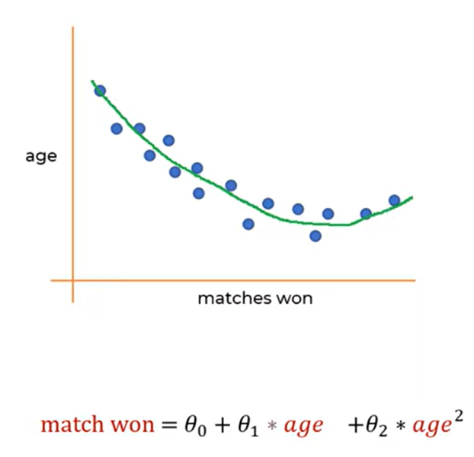

Example – Matches Won

Slide 8
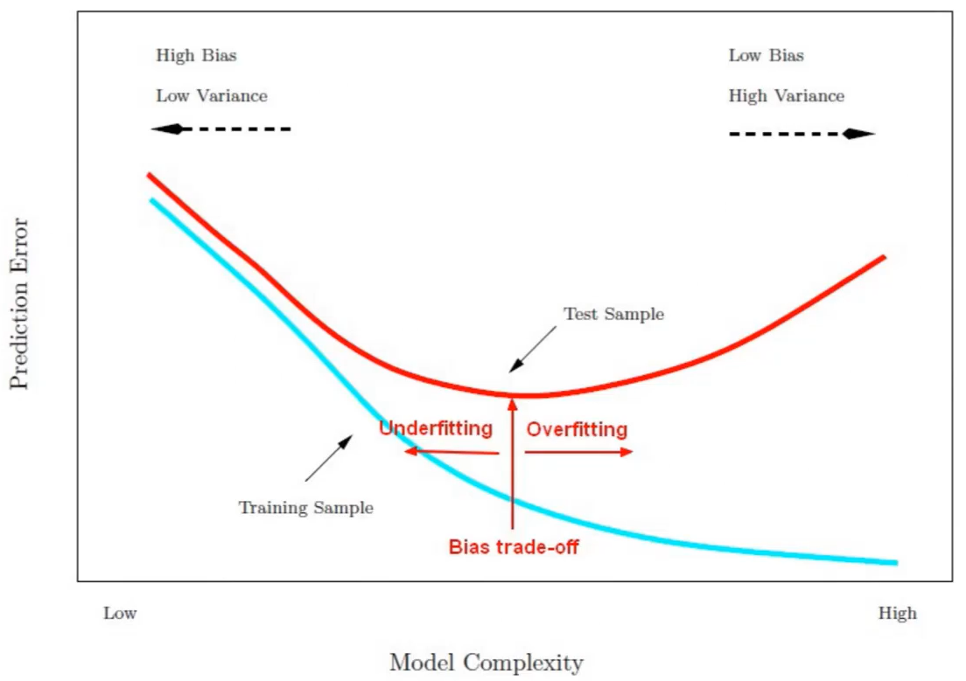
Bias-Variance Tradeoff
The bias-variance tradeoff is the balance between bias and variance to minimize total error and achieve a model that generalizes well to unseen data.
High Bias: The model is too simple, leading to underfitting. It has high training error and high test error.
High Variance: The model is too complex, leading to overfitting. It has low training error but high test error.

Slide 9
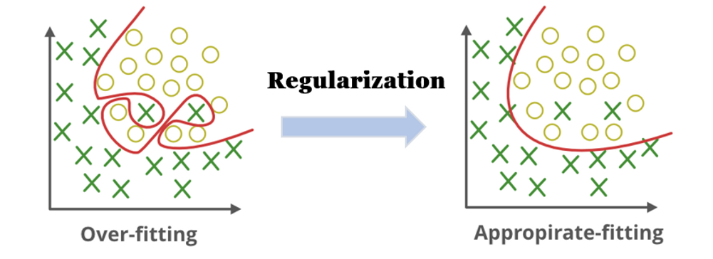
Regularization
Regularization is a technique used to prevent overfitting by adding a penalty to the loss function, which discourages the model from becoming too complex.
The goal is to balance the fit of the model to the training data with its ability to generalize to unseen data.
L1 Regularization (Lasso Regression): Adds a penalty equal to the absolute value of the magnitude of coefficients. This can lead to sparse models where some coefficients become zero, effectively selecting a subset of features.
L2 Regularization (Ridge Regression): Adds a penalty equal to the square of the magnitude of coefficients. This tends to shrink the coefficients but usually does not set them to zero, which can be useful when you believe all features contribute to the outcome but should be scaled down.

Slide 10
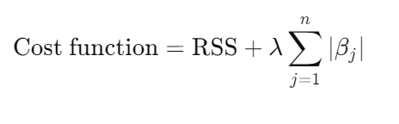
L1 Regularization- Lasso (Least Absolute Shrinkage and Selection Operator)
It prevent overfitting by penalizing the absolute sum of the coefficients.
It has the unique ability to reduce some coefficients to exactly zero, effectively performing feature selection.
In Lasso regression, the cost function is modified by adding a penalty equal to the absolute value of the magnitude of coefficients.
The objective is to minimize this cost function:
Where
RSS (Residual Sum of Squares) is the sum of the squared differences between the observed and predicted values.
λ lambda -> λ is a tuning parameter that controls the strength of the penalty. A larger λ\lambdaλ means more regularization, and a smaller λ\lambdaλ means less.
Βj beta_j -> βj​ are the coefficients of the model.

Slide 11
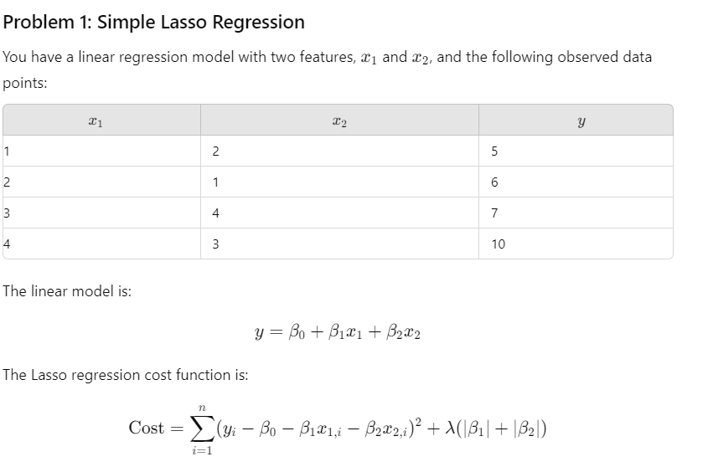
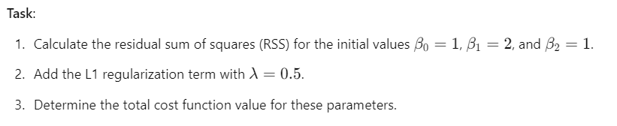

Slide 12
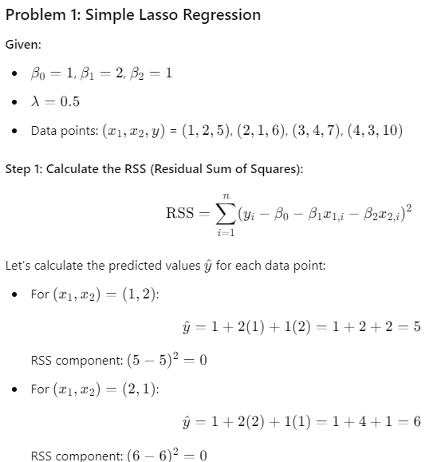
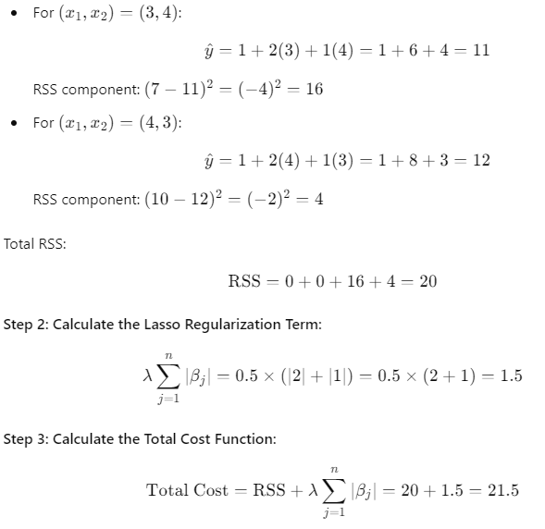

Slide 13
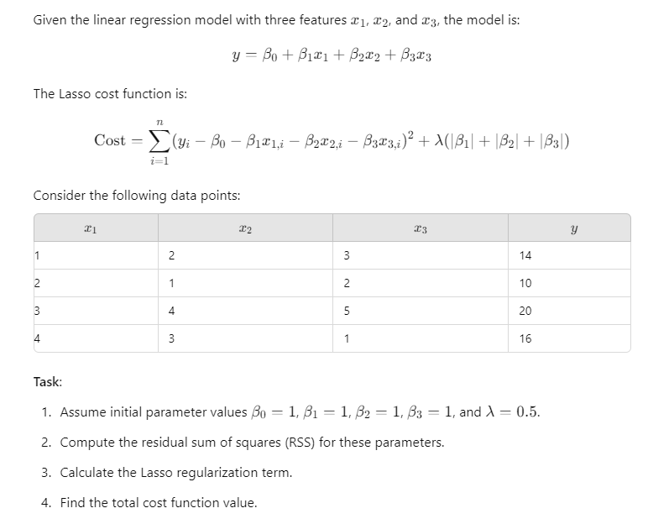
Problem 2: Multi-Feature Lasso with Regularization

Slide 14
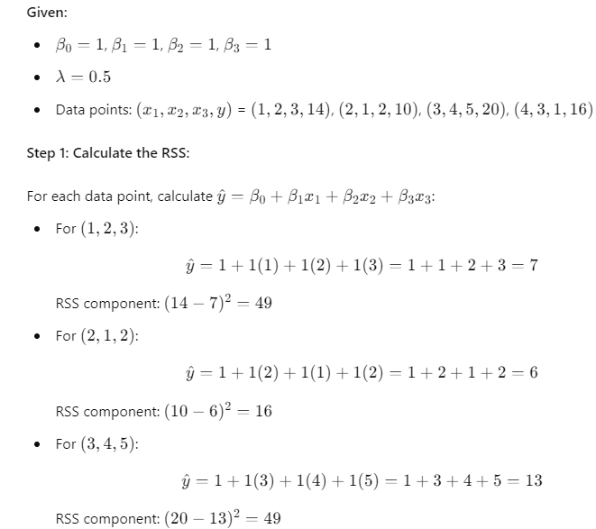
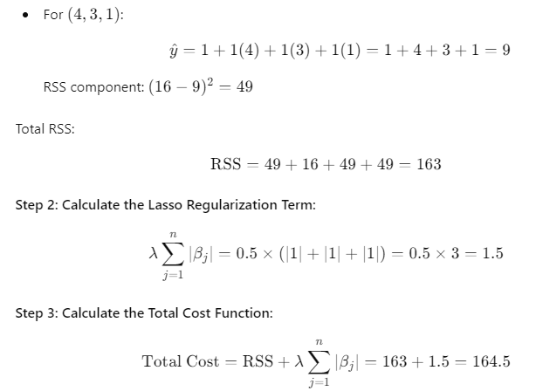
Problem 2 : Solution

Slide 15
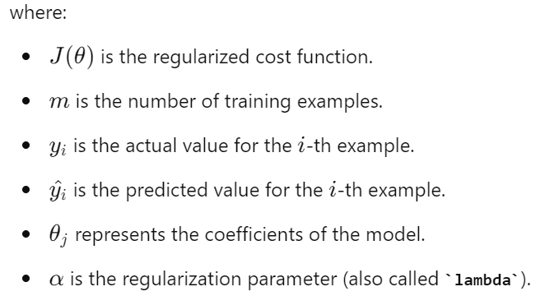

L2 Regularization -Ridge Regularization,
It prevent overfitting by adding a penalty term to the loss function.
This penalty term is proportional to the square of the magnitude of the model coefficients.
The main goal of L2 regularization is to reduce the complexity of the model by penalizing large coefficients. This helps in making the model more generalizable and reduces overfitting.
L2 regularization adds a term to the loss function which is the sum of the squared values of the coefficients multiplied by a regularization parameter (alpha).
Mathematically, the regularized cost function for linear regression with L2 regularization can be expressed as:

Slide 16
Coordinate Descent in Lasso Regression
What is Coordinate Descent?
Optimization algorithm for large-scale problems.
Works by minimizing one feature (variable) at a time.
Efficient for models with L1 regularization like Lasso regression
Predicting House Prices Example:
Predict the price of a house using features like size, location, number of rooms, age of house, swimming pool.
The algorithm updates coefficients for each feature, shrinking irrelevant ones to zero (e.g., "swimming pool").

Slide 17
How Does Coordinate Descent Work?
Step-by-step optimization of each feature’s coefficient.
Iteratively updates each coefficient while keeping others fixed.
Finds the best coefficient for each feature, moving feature by feature.
Convergence and Efficiency
Coordinate descent is computationally efficient, even for high-dimensional data.
The algorithm stops when the solution converges (when changes in coefficients become small).

Slide 18
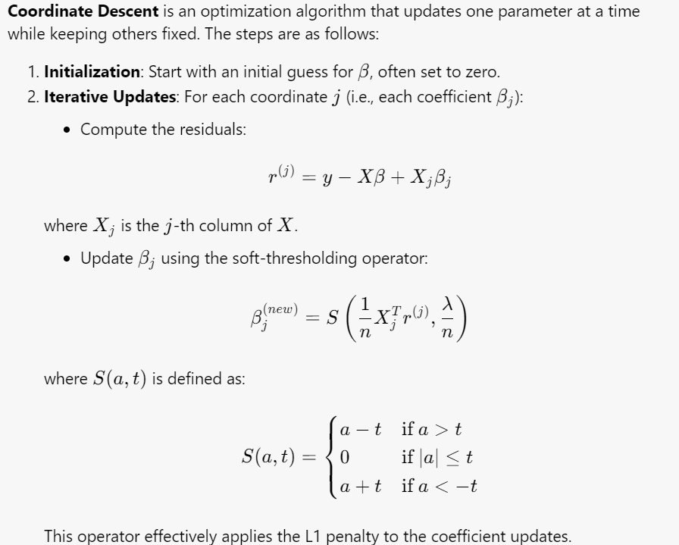
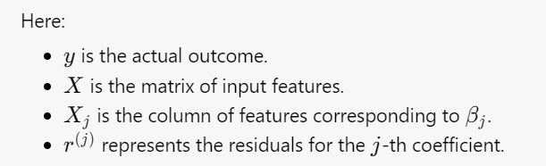
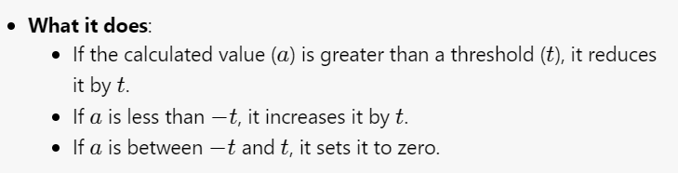
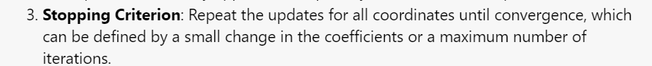

Slide 19
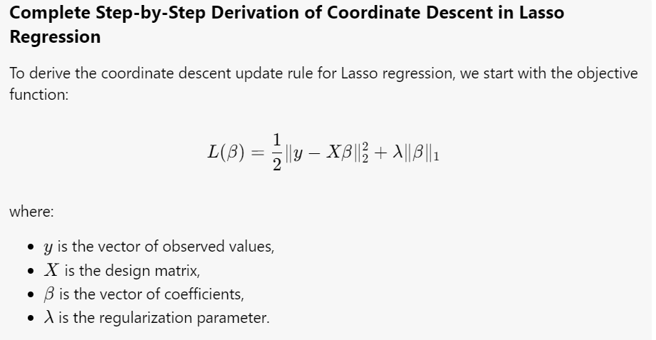

Slide 20
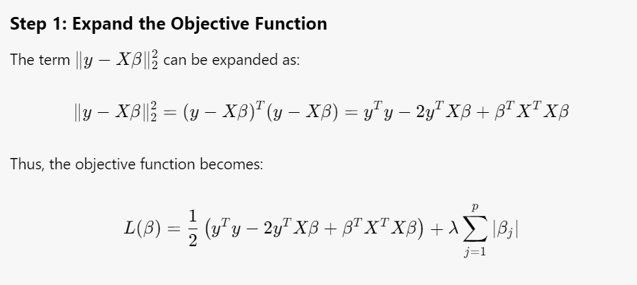

Slide 21
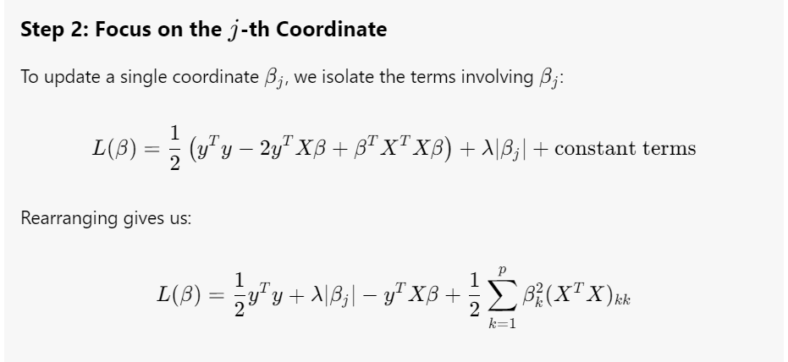

Slide 22
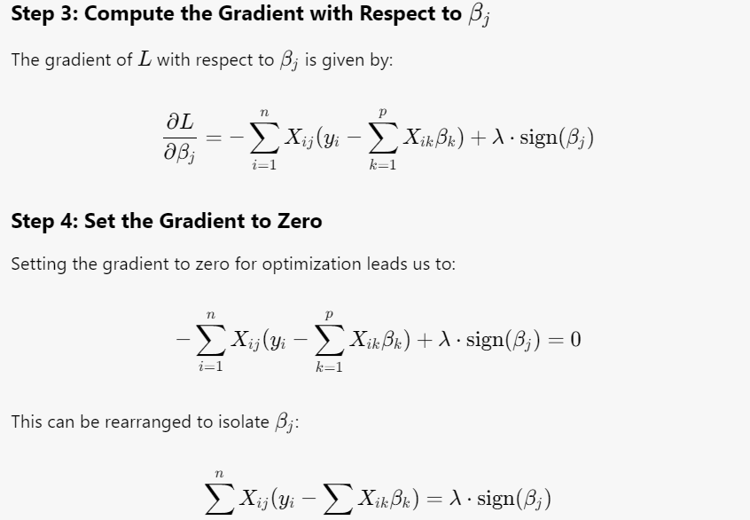

Slide 23
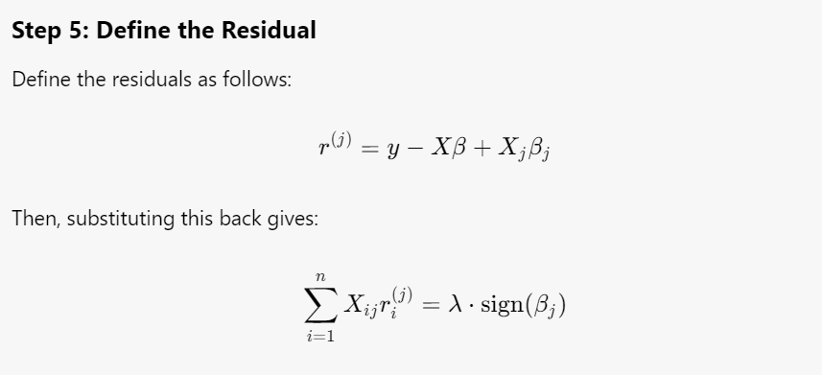

Slide 24
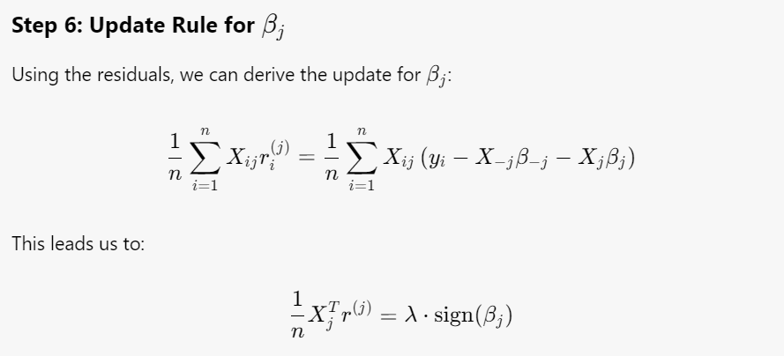

Slide 25
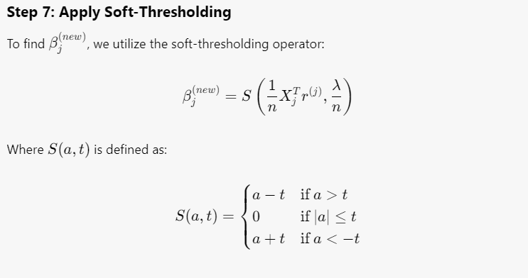

Slide 26
Process Flow
Start
Initialize beta
For each j ->
Compute residual
Calculate Gradient
Update beta_j using soft-thresholding
Repeat until convergence
Stop

Slide 27
Benefits of Coordinate Descent
Efficient for high-dimensional data.
Automatically selects the most important features.
Helps in reducing model complexity and improving interpretability.

